Slide 1
Flight Data Analysis Workshop with MATLAB Jenet Peng (jenetp@mathworks.com) Technical Account Manager, MathWorks Timothy Kyung Application Engineer, MathWorks

Slide 2



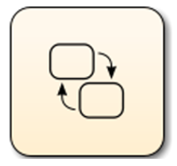
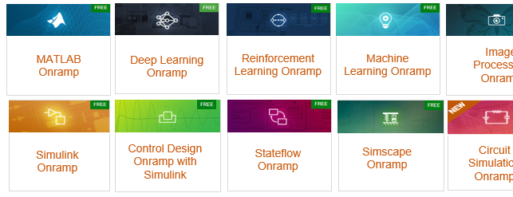
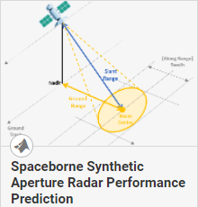


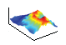
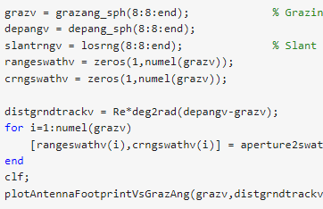



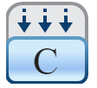
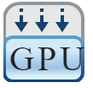
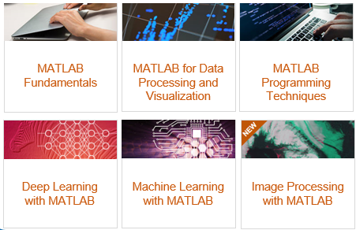
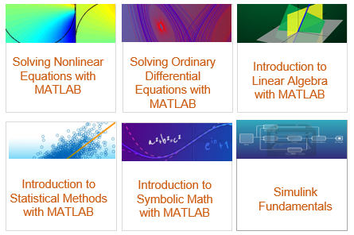
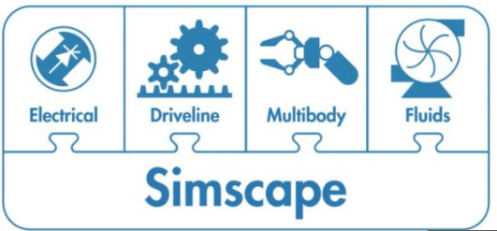


Take Advantage of RTX’s Enterprise License:
Unlimited access to MathWorks’ online training
NEW RTX User Community Resources Site
Unlimited access to MathWorks’ 100+ tools
Onramps (intro courses):
Examples with Executable Code
Advanced courses:
Dedicated Application Engineer Support

Slide 3
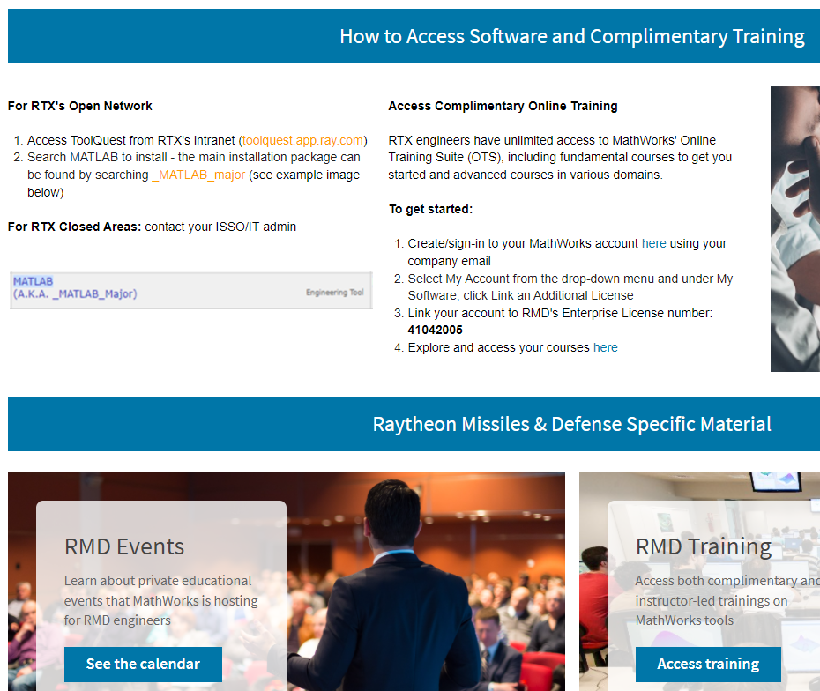


Visit Your RTX User Community Resources Site
Get BU-specific info, such as accessing software and online courses
Explore technical content aligned with RTX’s key initiatives and view past webinar material
View and sign up for RTX private events

Slide 4
























Free, Unlimited Access to MathWorks’ Online Self-Paced Training
View the latest online catalog
Access the courses in three easy steps (directions for RIS and RMD)
MATLAB
Onramp
Deep Learning Onramp
Reinforcement Learning Onramp
Machine Learning Onramp
Image Processing Onramp
Signal Processing Onramp
Optimization
Onramp
Simulink
Onramp
Control Design Onramp with Simulink
Stateflow Onramp
Simscape Onramp
Circuit Simulation Onramp
Wireless Communications Onramp
MATLAB
Fundamentals
MATLAB for Data Processing and Visualization
MATLAB Programming Techniques
Solving Nonlinear Equations with MATLAB
Solving Ordinary Differential Equations with MATLAB
Introduction to Linear Algebra with MATLAB
Deep Learning with MATLAB
Machine Learning with MATLAB
Image Processing with MATLAB
Introduction to Statistical Methods with MATLAB
Introduction to Symbolic Math with MATLAB
…and much more!

Slide 5
Flight Data Analysis Workshop with MATLAB Jenet Peng (jenetp@mathworks.com) Technical Account Manager, MathWorks Timothy Kyung Application Engineer, MathWorks

Slide 6
Agenda
Data Analysis with MATLAB
Workshop
Introduction to MATLAB environment
MATLAB Built-In Tools
Data Analysis
Access
Explore
Share
Deploying graphical applications
Resources

Slide 7

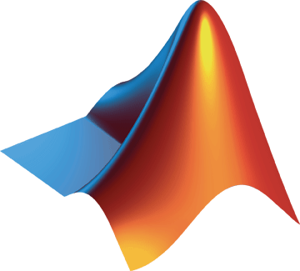
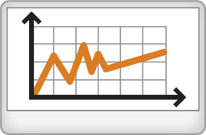




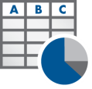


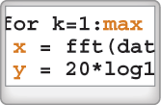


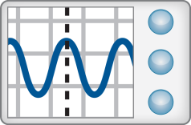
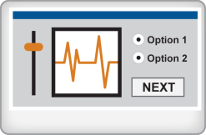
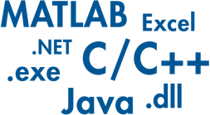
Technical Computing Workflow
Access
Explore & Discover
Share
Files
Reporting and Documentation
Data Analysis & Modeling
Software
Algorithm Development
Outputs for Design
Code & Applications
Application Development
Hardware
Deployment
Automate

Slide 8
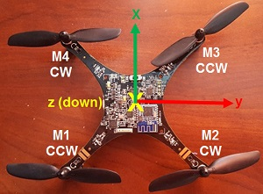
Demo: Quadcopter IMU Flight Data Analysis Introduction to Data Analysis with MATLAB
Goal:
Estimate / Characterize quadcopter IMU noise for specific flight phases
Approach:
Collect IMU Flight Data
Handle any messy data (outliers, missing records, etc.)
Partition data by flight phase
Analyze data statistics
Document analysis in a report

Slide 9
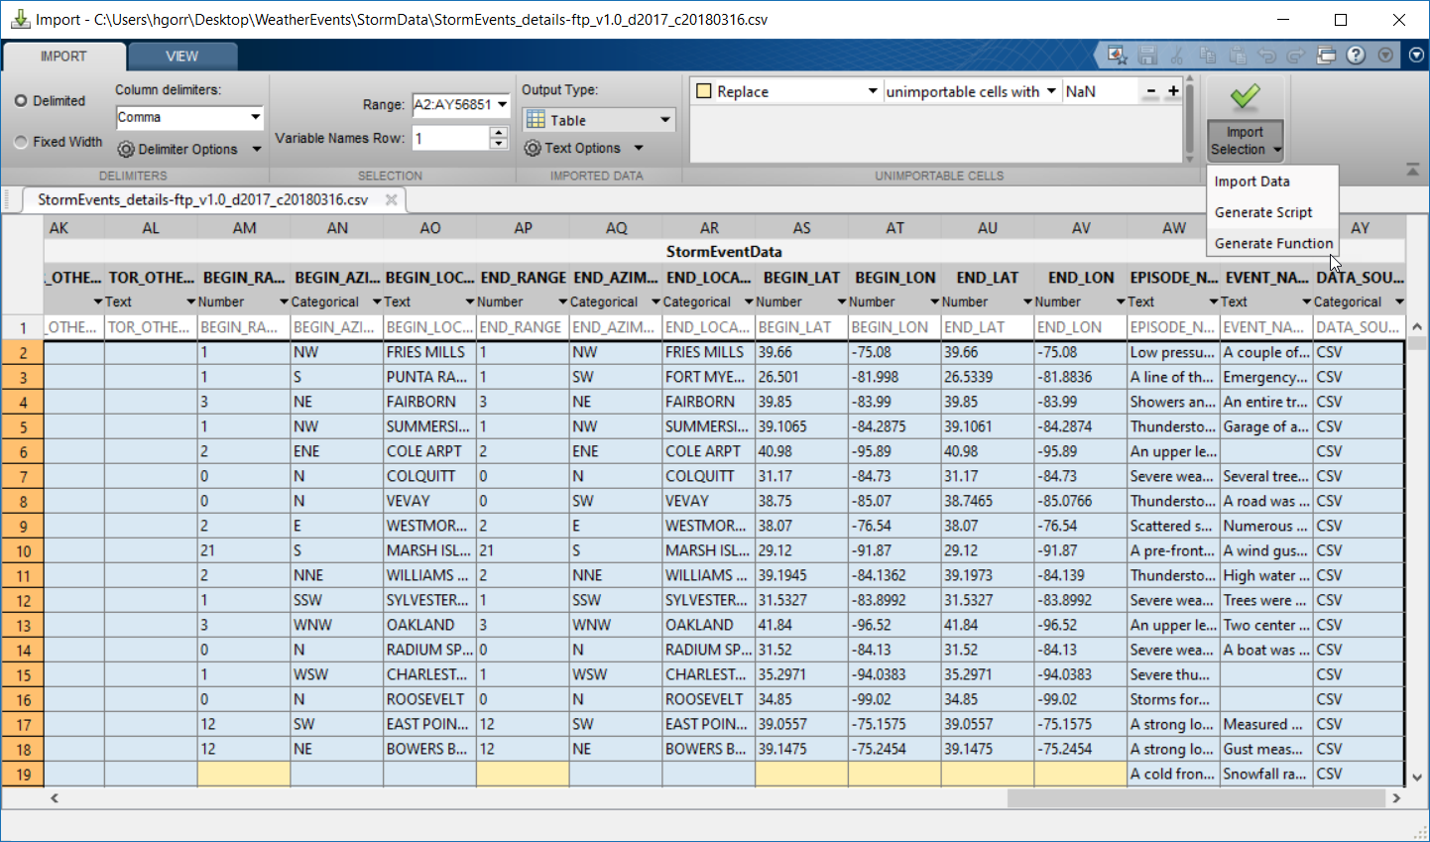
Access data interactively using the Import Tool
Select data types
Choose what to do with missing data
Generate MATLAB code
Notes:
Detects data types automatically – gives you a preview, with options to modify
This can tee up “detectImportOptions”
It’s for more explicit control
Then you can use those options with datastores
Import tool runs that function, and returns an object (e.g., spreadsheetImportOption object)
Generates code for you

Slide 10

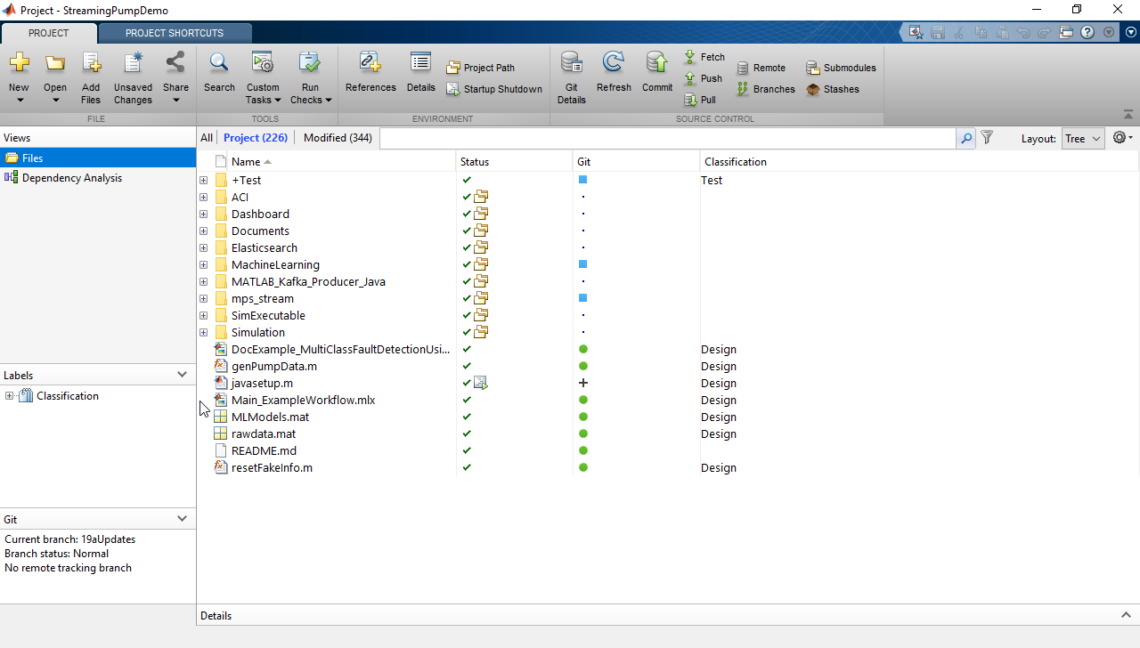
Organize, manage, and share your code with MATLAB projects
Configure your environment
Analyze dependencies
Track and control changes
Package and share projects
Write & Execute >> Organize >> Test & Share
Notes:
Starting in R2019a, you can use projects in MATLAB to organize, manage, and share your code. This functionality is just like Simulink projects.
Configure your environment
Set and manage project paths across teams
Automate tasks (like startup/shutdown scripts), processes, and file management
Analyze dependencies and the impact of file changes
Track and control changes using built-in integration with Git and Subversion (SVN), or use external source control tools
Package and share projects with others

Slide 11

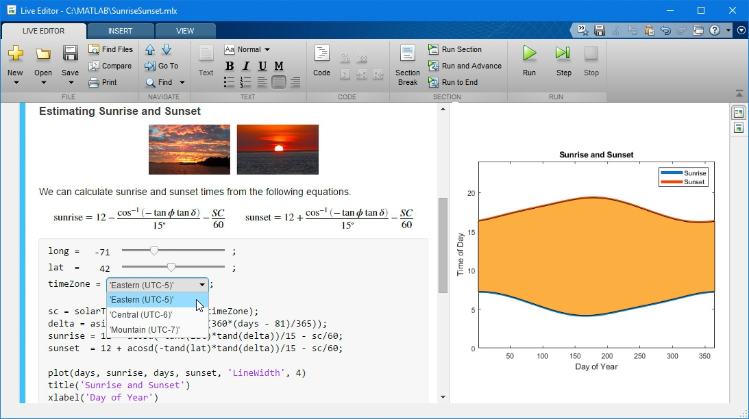
Create scripts that combine code, output, and formatted text in an executable notebook
Live Editor
https://www.mathworks.com/products/matlab/live-editor.html
Notes:
Use this slide to introduce/define the Live Editor; explain that it was first introduced in R2016a, and we have been actively investing in it, with updates each release since.
DEMO: Show the Calculus demo, or a Live Script of your choice.
Key new features by release are included here:
21a
Create dynamic controls in live scripts by linking variables to drop-down items and slider values
Change the name, style, size, and color of fonts programmatically using settings
Navigate quickly between lines with bookmarks
Live Editor Animation Playback Controls: Interactive interface to control animations
Live Editor Performance: Improved performance when saving large live scripts or functions
20b
Create, edit, and run live scripts in MATLAB Mobile on iPhone and iPad
Use a live script hyperlink to open another live script
Batch export all live scripts and live functions in a folder to PDF, HTML, LaTeX, or Word
Specify the size of images and add alt text for use with screen readers
20a
There is improved performance when running loops and animating plots in live scripts
Additionally, the overall stability is improved for long-running sessions
19b
Live Editor Tasks are apps that can be included in scripts; use them to interactively explore parameters and options, preview results based on those parameters and options, and automatically generate the corresponding MATLAB code. 19b focus is primarily on preprocessing tasks in MATLAB, but there are also a few in the controls area.
Animate plots option no longer requires environment variable setting
Customize figure format as well as document paper size, orientation, and margins when exporting
Add Chinese, Japanese, and Korean characters on Windows and macOS Platforms
19a
Interactive controls
3 new ones – check boxes, edit fields, and buttons
Ability to specify what code gets run when a control value changes
Ability to hide code when sharing and exporting live scripts with interactive controls
Save as Microsoft Word documents
Enable animations in plots
18b
Use additional subheading styles (Heading 2, Heading 3)
Add internal hyperlinks to navigate within a live script
Filter table output interactively – then automatically generate MATLAB code to update the script
18a
Debug functions and scripts
Use interactive controls to modify values in a script
17b
Context-aware coding guides
Save directly to PDF, HTML, and LaTeX

Slide 12
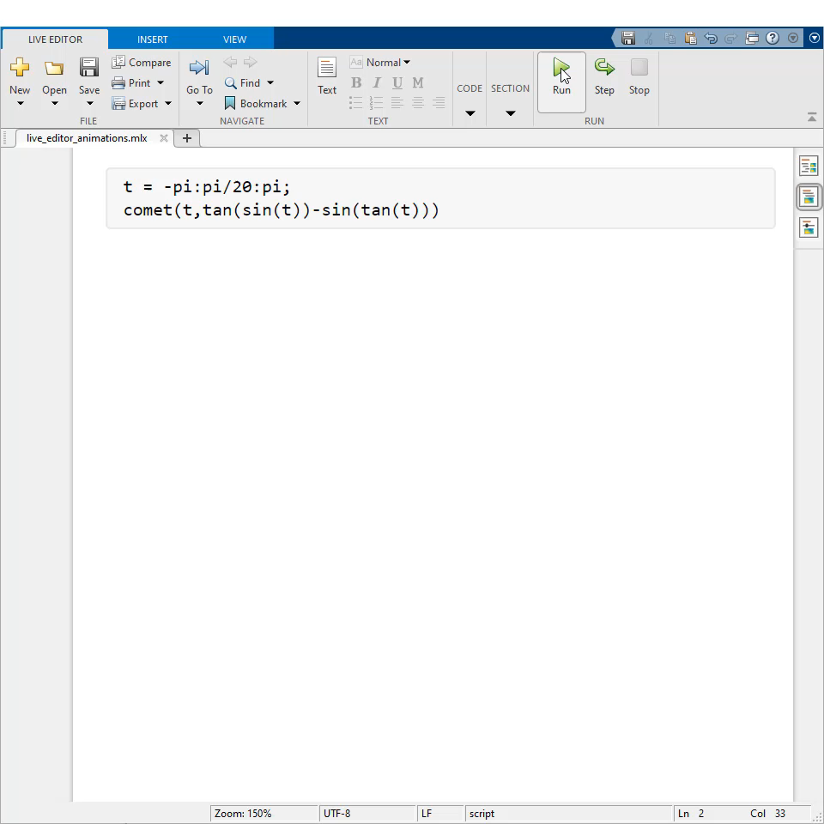
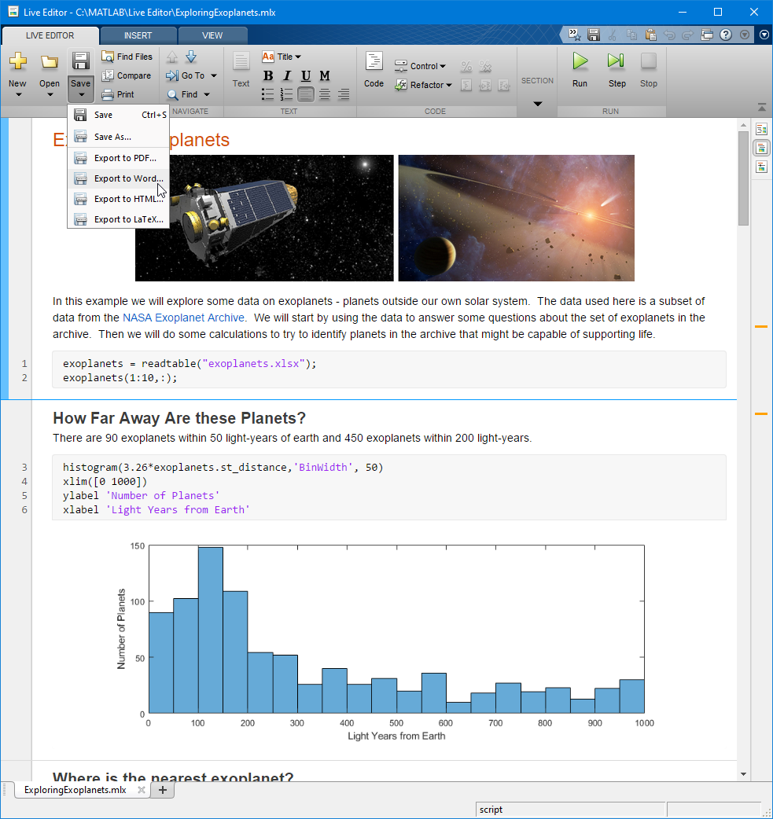
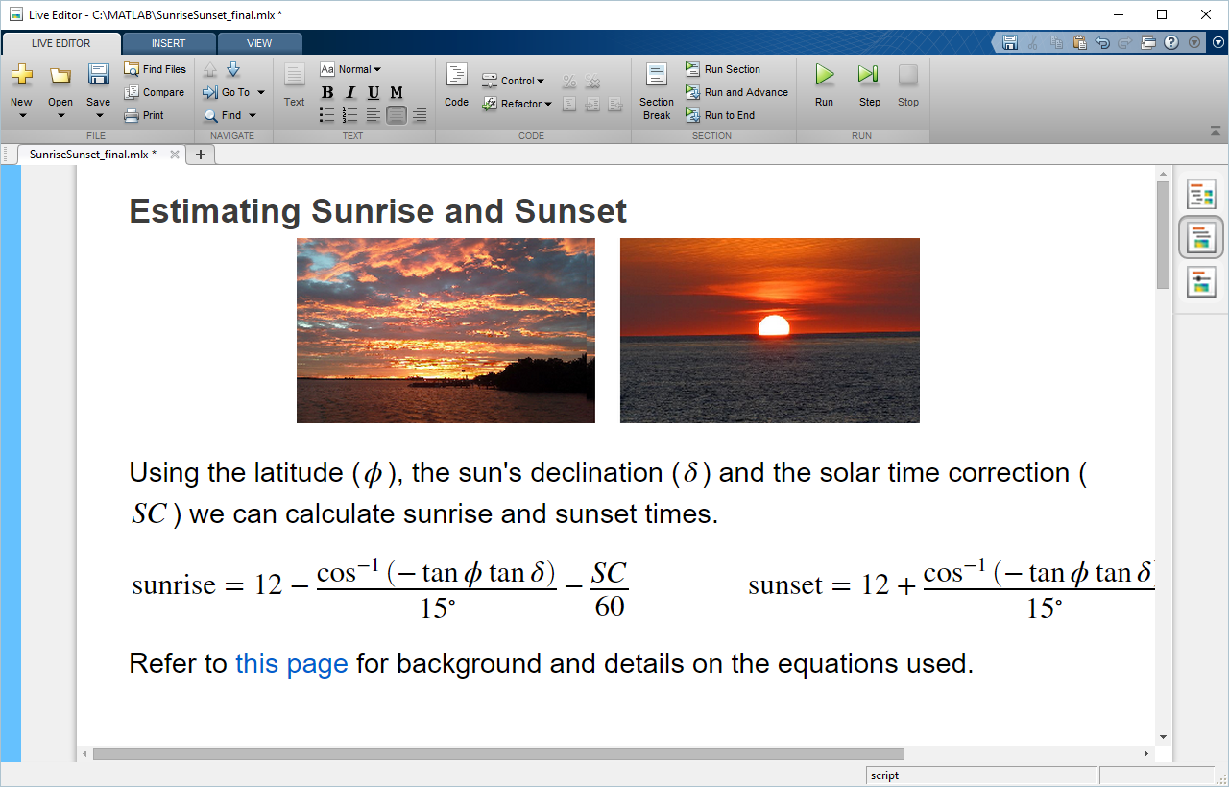
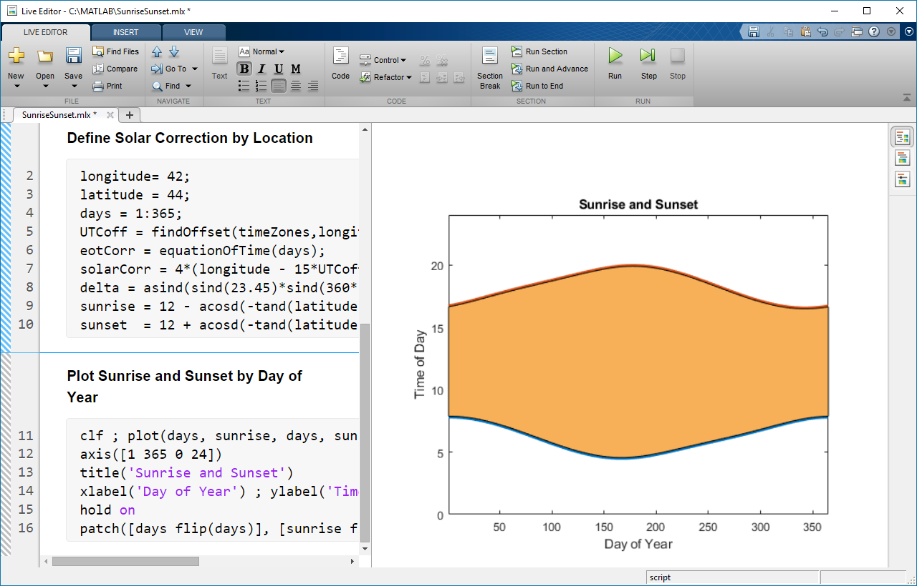
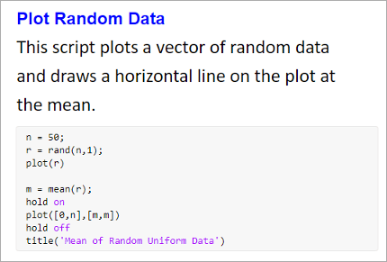


Document as you go – your script is your report
Code + Output + Formatted Text
Executable Notebook
Divide code into sections
Embed outputs next to the code
Add rich text formatting, equations, images, and hyperlinks
Include animations with embedded controls , and export
Programmatically control fonts
Save directly to PDF, HTML, Word, and LaTeX
Notes:
Share results of MATLAB analysis
- Divide code into sections that can be executed independently, and
- View output next to the code that generated it
(click)
- Add rich text formatting, equations, images, and hyperlinks
- NOTE – in 20b, you can hyperlink to another live script. This is great for AE demonstrations, as well as for presenting and teaching use cases
(click)
Enable animations in plots
[NOTE – this required an environment variable to be set in 19a; this requirement is removed in 19b]
NOTE – in 21a, playback controls appear within the figure window after an animation is done playing. This works for animations covered on this page – except for those related to the movie function
https://www.mathworks.com/help/releases/R2021a/matlab/animation-1.html
21b adds the ability to export animations to movies or animated GIFs
(click)
Starting in 21a, you can programmatically control the name, style, size, and color of fonts using settings
(click)
- Save directly to PDF, HTML, Word, and LaTeX (click) - Here’s an example Word document generated from a live script.
- NOTE – in 20b, you can batch export all live scripts and live functions in a folder to PDF, HTML, LaTeX, or Word
(click)
This combination of code, together with the corresponding output and formatted text results in an executable notebook.

Slide 13
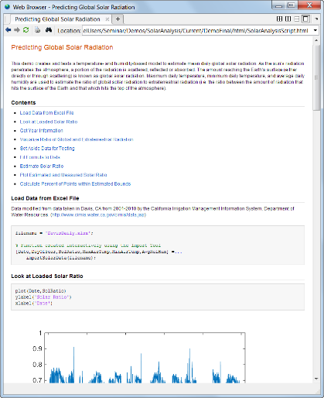
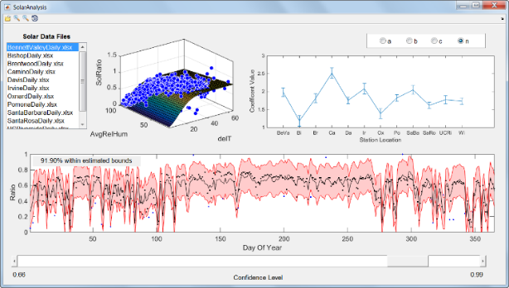
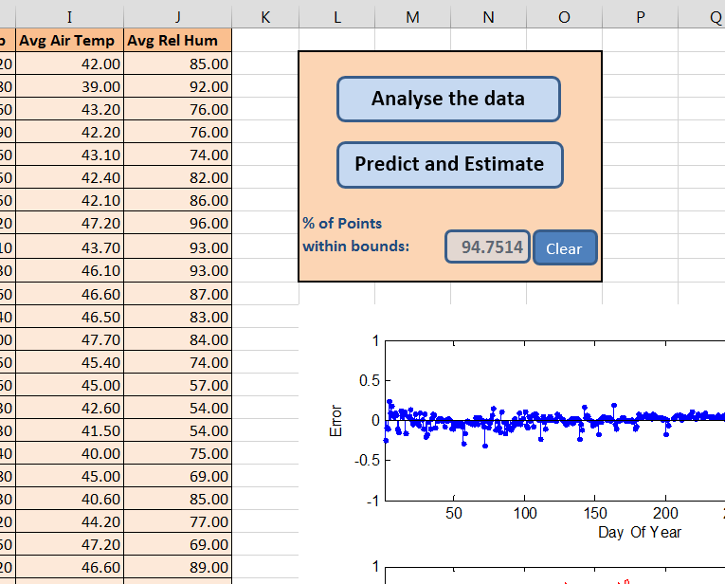
Sharing Results from MATLAB
Automatically generate reports
Create and package applications
Deploy to other environments
Notes:
If you are doing any type of testing or analysis, eventually you will have a need to share your results. The majority of the time this will be with others outside of MATLAB. With core MATLAB, you can copy-paste figures into other applications, or write scripts to automatically export many figures at once. You can also import and export standard or custom files.
There are also few products which extend the ability to share your work beyond MATLAB’s core capabilities. The Database Toolbox allows MATLAB to exchange data with ODBC and JDBC compliant databases, and the report generator will embed your MATLAB work into HTML, Word, or PDF documents.
All these capabilities can be integrated right into your Test and Measurement Application. We will soon see a example of this.

Slide 14
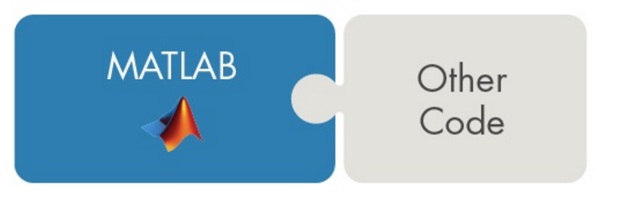

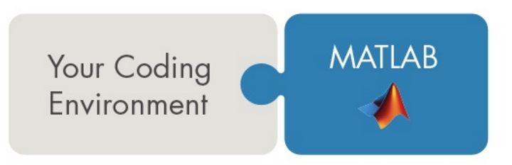
Using MATLAB with Other Languages
Calling Libraries Written in Another Language From MATLAB
Java
Python
C
C++
Fortran
COM components and ActiveX® controls
RESTful, HTTP, and WSDL web services
Call C++ libraries directly from MATLAB
+
Calling MATLAB from Another Language
Java
Python
C/C++
Fortran
COM Automation server
Write & Execute >> Organize >> Test & Share
Notes:
Example talking points:
MATLAB is very flexible.
You can call code written in other languages from within MATLAB
The C++ interface was updated in R2019a – you can now call C++ libraries directly from MATLAB; and in 20b, you can build a MATLAB interface to a C++ library or algorithm from source files that contain complete implementations for the library.
For R2021a, the C++ interface has added support for:
Function pointers
Function and member function templates
void* as a new type
You can also call MATLAB from within other languages
Active development on deeper support for other languages and easier data marshaling

Slide 15

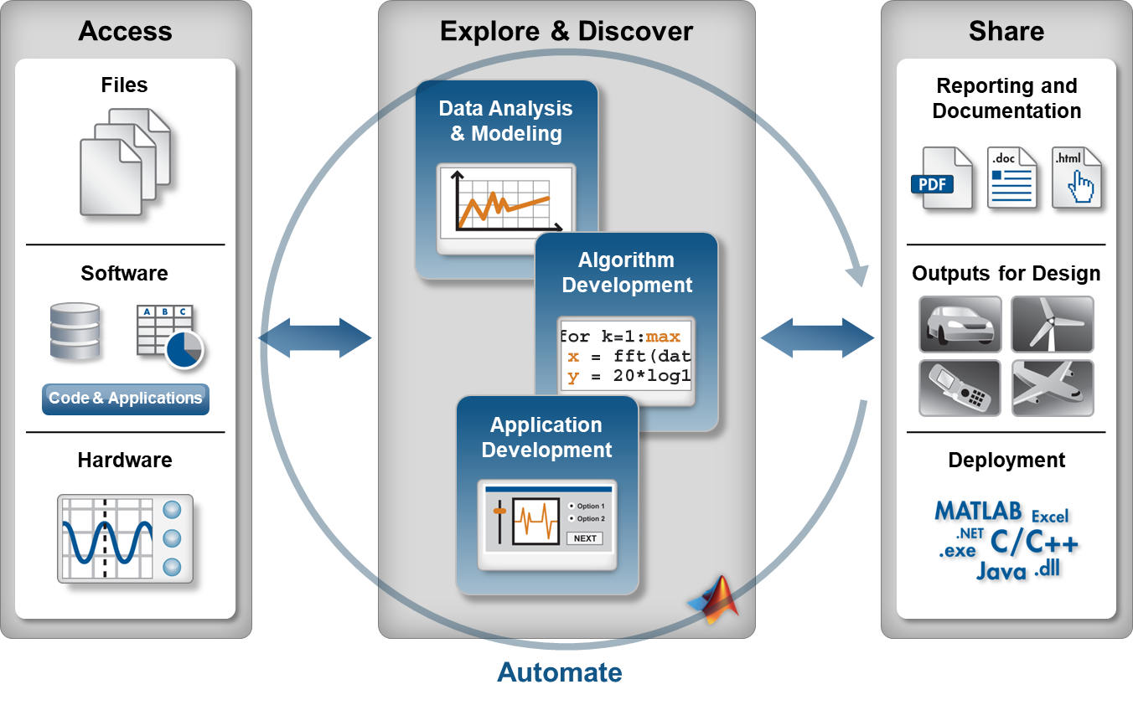
Demo Summary
Show how to set up script and import data into MATLAB for analysis
Demonstrate how to enhance data analysis workflows with MATLAB
Show how to share analysis results with others via MATLAB
Notes:
Today, I have 3 things I would like to accomplish.
First, I’d like to introduce MATLAB from the lens of a programming language. While MATLAB is primarily known as a tool for engineers and scientists for solving technical problems, it is also a full programming language. To support the MATLAB language, it comes with various development tools to help users use the language to its fullest.
Through a couple of examples, I’d like to show you how you can make use of these development tools to program effectively in MATLAB.
Finally, I’d like to demonstrate the wide range of programming styles that MATLAB supports. You can quickly start programming interactively via the command line, start collecting commands together into scripts and functions, and even create full-fledged applications using object-oriented programming.

Slide 16
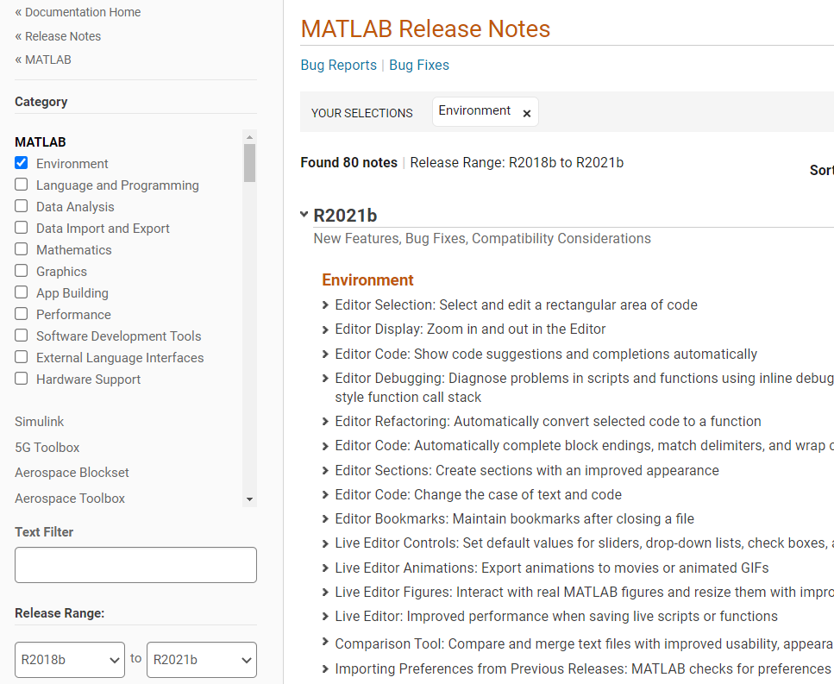
There’s much more available than we can cover today Build your own custom release notes
Filter results by:
Category
Release range
Specific search terms
Notes:
Point out that you won’t have time to cover everything – but they should always know that the release notes in the documentation provide details for everything. And there are ways to filter the results down to something manageable, specifically by specifying:
The documentation category
The release range of concern
And/or specific search terms
Note that as long as they have internet access, this provides them with access to the release notes for all releases, even if they’re on an earlier release.

Slide 17


MATLAB Central Community
Every month, over 2 million MATLAB & Simulink users visit MATLAB Central to get questions answered, download code and improve programming skills.
Blogs
Answers
Blogs
MATLAB Answers: Q&A forum; most questions get answered in only 60 minutes
MATLAB Answers
File Exchange: Download code from a huge repository of free code including tens of thousands of open source community files
File Exchange
ThingSpeak
Cody: Sharpen programming skills while having fun
Blogs: Get the inside view from Engineers who build and support MATLAB & Simulink
Learn
Contribute
Connect
Cody
and more…
ThingSpeak: Explore IoT Data
And more for you to explore…

Slide 18


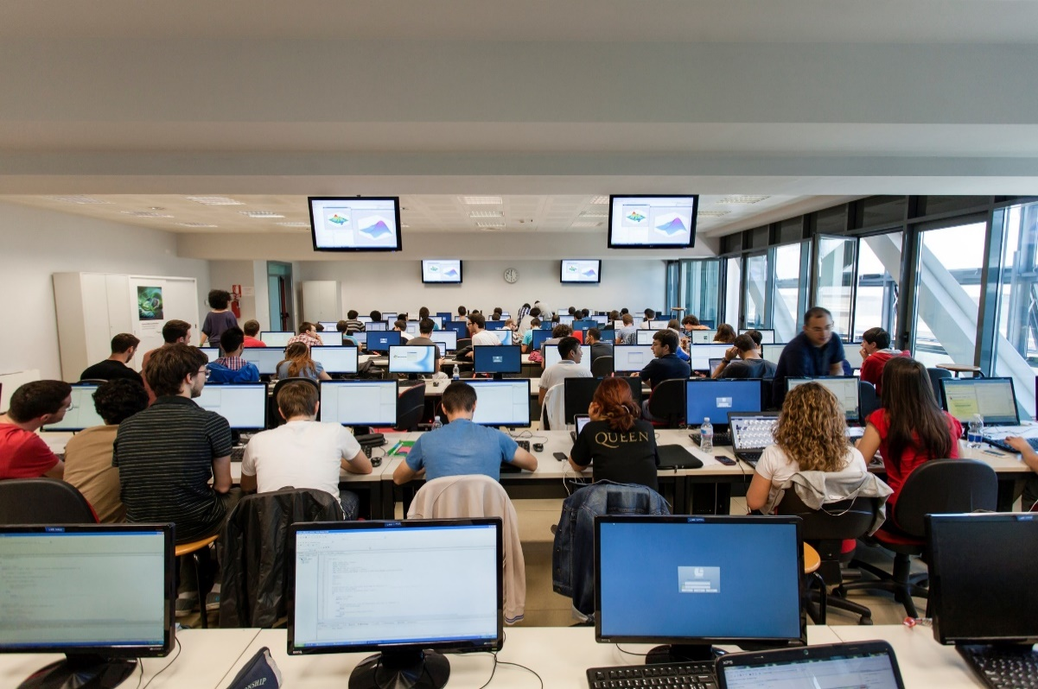


MathWorks Engineering Support
Training
Guided Evaluations
Onsite Workshops
Consulting
Technical Support
Notes:
MathWorks have engineers who:
Enable you to easily onboard new hires from different industries or new college graduates
Provide hands on sessions to demonstrate a variety of technical concepts
Work with you and your data to guide you through how deep learning could unlock value within your organization
Customize services based on your needs to optimize your investment and ensure your success.
Take your critical feedback so they can provide you with the fastest, most productive engineering platform available
Please let us know if you’re interested in engaging with us further on any of these options.

Slide 19
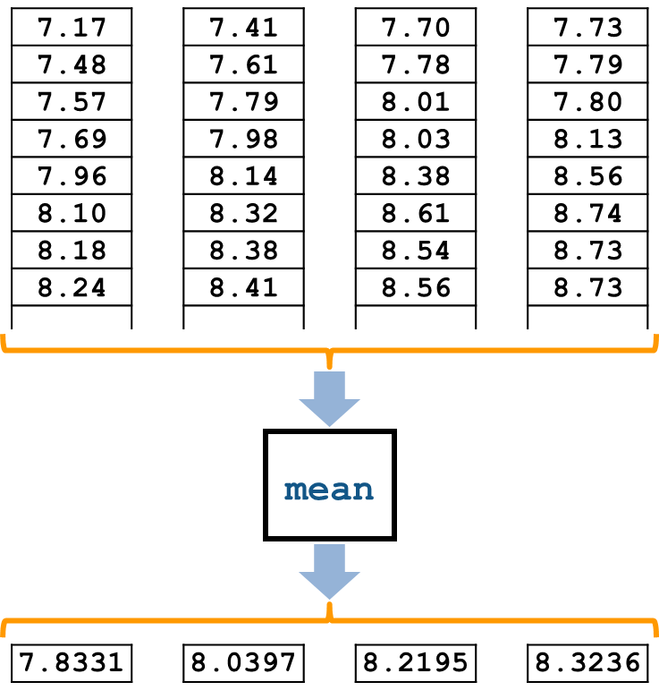
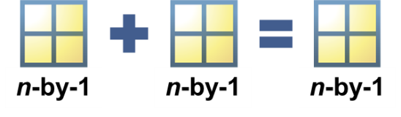
Training: MATLAB Fundamentals
After this 3-day course you will be able to:
Import, analyze, and export data
Write programs to automate complex tasks
Perform calculations and analysis on data sets
Create informative data visualizations
Notes:
Use: After any introductory MATLAB demo.
Target audience: all new users (including those who “used MATLAB 14 years ago in grad school”). Emphasis on Excel users; data analysts (but still very useful for programmers/algorithm developers/modellers). Useful for CDA people who need MATLAB basis, but is probably more than they need; commonly trimmed and combined with Simulink to make a custom onsite training.
What is in: Basics of MATLAB environment and language. Scripts & functions. Logic. Basic data analysis workflow (import, preprocess, compute & visualize).
What is not: sophisticated import (textscan), customized graphics [see MATLAB for Data Processing and Visualization]; serious programming stuff [see MATLAB Programming Techniques]; any applications with other toolboxes [see a bunch of other courses]; application building [see Building Interactive Applications with MATLAB for interface stuff and basic standalone deployment], deployment, code gen, or interfacing with other languages [see a bunch of other courses].
Prerequisites/level: Beginner level. No prereqs.
Course details: 3 days. Public or onsite. In person, online live, online self-paced.
Note: There are also automotive- and aerospace-specific variants. (Same concepts but different exercises [don’t need to reveal that to customers]) Can use this to persuade the obstinate.

Slide 20
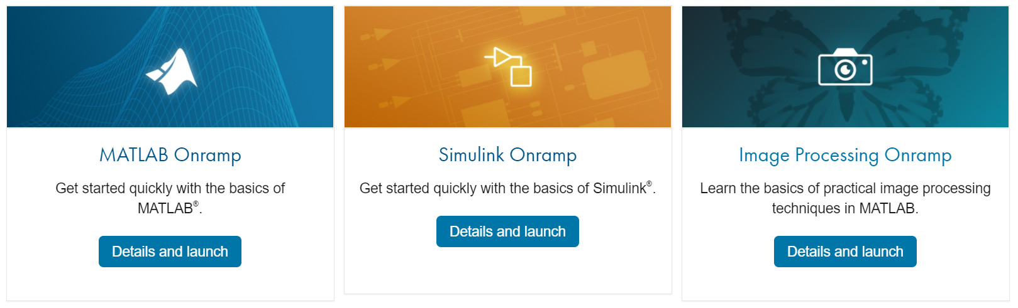
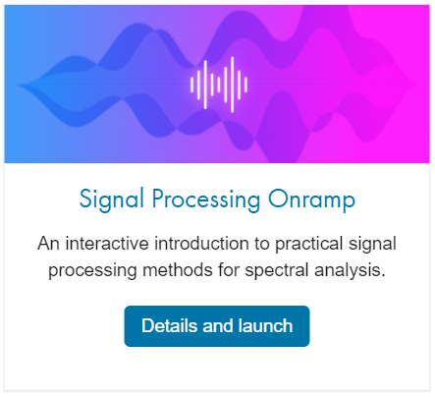
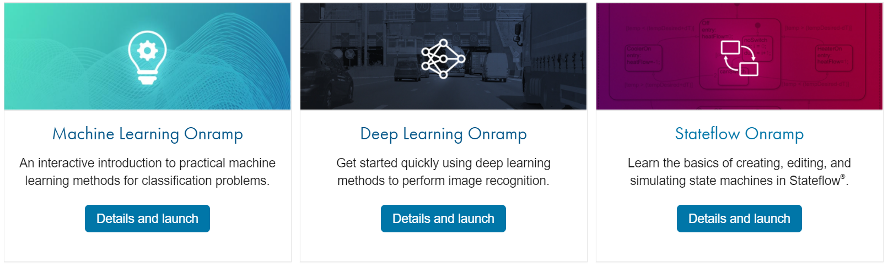
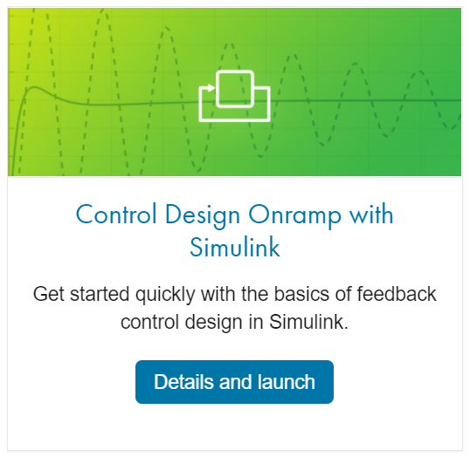
Get Started for Free with Onramp Courses
https://matlabacademy.mathworks.com/

Slide 22
Wrap-Up
Questions?
Notes:
If you are doing any type of testing or analysis, eventually you will have a need to share your results. The majority of the time this will be with others outside of MATLAB. With core MATLAB, you can copy-paste figures into other applications, or write scripts to automatically export many figures at once. You can also import and export standard or custom files.
There are also few products which extend the ability to share your work beyond MATLAB’s core capabilities. The Database Toolbox allows MATLAB to exchange data with ODBC and JDBC compliant databases, and the report generator will embed your MATLAB work into HTML, Word, or PDF documents.
All these capabilities can be integrated right into your Test and Measurement Application. We will soon see a example of this.

